Slide 1
Cobol 2 Describing Data
Joe Oakes
jxo19@psu.edu

Slide 2
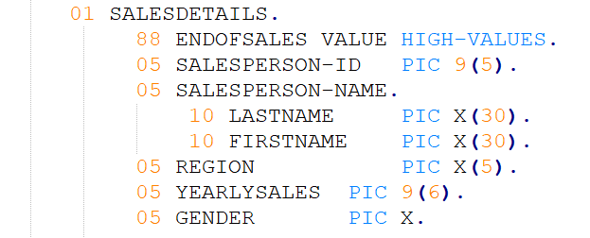
Cobol: Describing Data: Naming: Data
Naming: Data
Data names: are the elements on which instructions operate
for example - SALESPERSON-ID
Data names are used to represent field – as a basic fact
Naming Rules
must contain letters, numbers
optionally a hyphen
May not begin with or end with a hyphen
Maximum of 30 characters
Cannot use reserved words: SUM, ADD, DATA
Must contain at least one letter

Slide 3
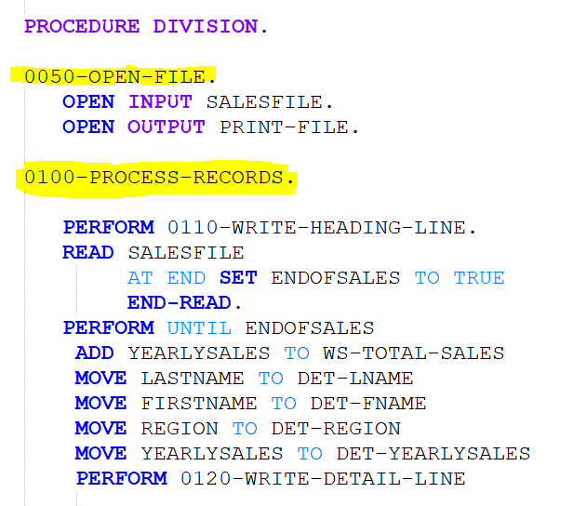
Cobol: Describing Data: Naming: Paragraph
Naming: Paragraph
All code is enclosed in paragraphs
A paragraph name is a tag to which the program refers
It is a common practice to number the paragraphs for readability (see highlighted example on right)
Cobol doesn't care about the numbering scheme it for programmer readability and code organization
Paragraph name could be all numeric or it can contain numbers and letters or a hyphen

Slide 4
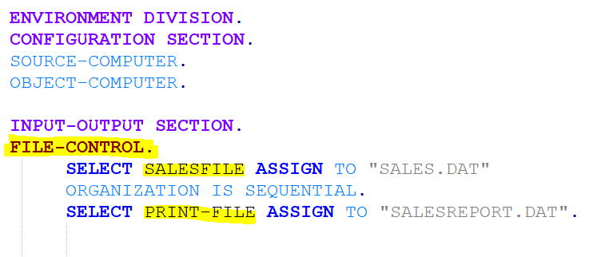
Cobol: Describing Data: Naming: File Names
File Names start to appear in the Environment division
Notice file SALESFILE and PRINT-FILE highlighted in yellow on the right
Naming: Paragraph
Paragraphs:
File Names

Slide 5
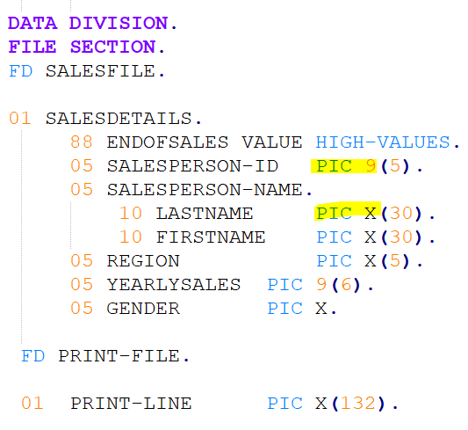
Cobol: Describing Data: Naming: Picture Clauses
Picture clauses are used to describe the nature of the incoming or outgoing data
A picture clause using all 9s means it is numeric
A picture clause using all Xs means the entry is alphanumeric – which includes letters, numbers and special characters
Data types are defined as part of the file section
A file is a set of records
A record is a set of fields

Slide 6
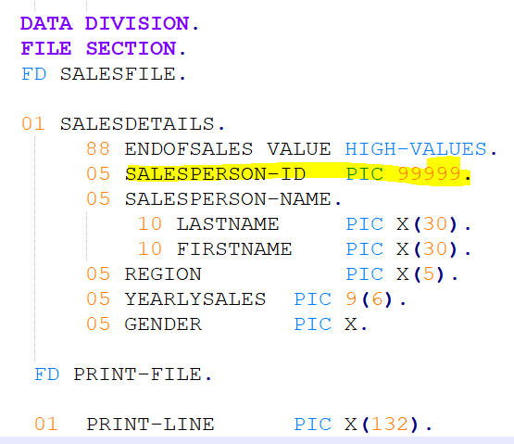
Cobol: Describing Data: Naming: Data Fields
Additional data fields might be needed
for temporary storage
for calculations
To represent switches to control paragraph execution
Can hold constant values that do not change
SALESPERSON-ID is a numeric field and has 5 numbers
It could also be written as PIC 9999 which is the same as PIC 9(5)

Slide 7
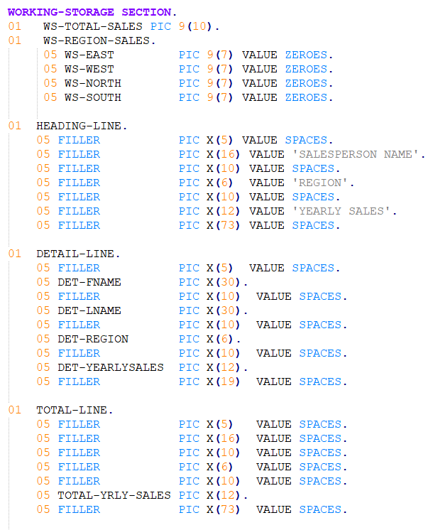
Cobol: Describing Data: Naming: Working Storage
Working storage is used to define the record layouts for reports
The HEADING-LINE is the line that contains all the information that would be heading on a report
The DETAIL-LINE is used to print out each salesperson separately – region and their yearly sales
The TOTAL-LINE is used to print the report totals
Notice FILLER is a keyword – it is used a placeholder. It defines a field that is not referenced anywhere else in the Cobol program

Slide 8
Cobol: Describing Data: Naming: Working Storage
Each variable can also have a value clause
Value spaces
Value zeros
Initial value
The value clause initializes the content of the data name within that working storage section
Notice the values in the HEADING-LINE: SALESPERSON NAME, REGION AND YEARLY SALES which are the column names

Slide 9
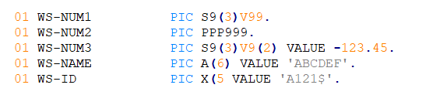
Cobol: Describing Data: Naming: Working Storage
Some variables can contain a sign
PIC type variables include a S at the start of the variable size
Notice WS-NUM1
S means it could be positive or negative
V means decimal
P is an assumed decimal
Notice WS-NAME
A clause – can contain alphanumeric
X clause – can contain numbers, letters and special symbols

Slide 10
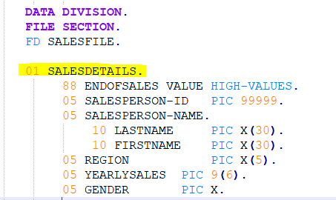
Cobol: Describing Data: Naming: Data Types
To start a new data name you need specify the level number
01 for a field description entry and group level items.
Level 01 might have 1 or more elementary items associated with the group items
02-49 are elementary items
66 is reserved for the rename clause
77 is items that cannot be subdivided
88 is for condition name entries

Slide 11
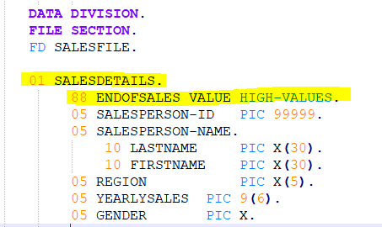
Cobol: Describing Data: Naming: Data Types
Notice the group item 01 SALESDETAILS
Below that is ENDOFSALES VALUE 88 Level which gets set to HIGH-VALUES – indicates the end of file
SALESPERSON-ID is an elementary item
SALESPERSON-NAME is a group item that contains two elementary items LASTNAME and FIRSTNAME

Slide 12
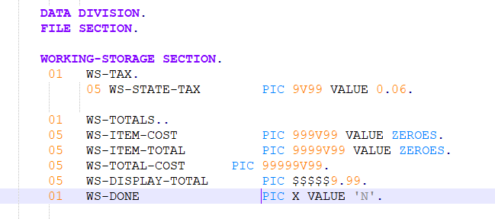
Cobol: Naming: Literal and Figurative Constants
A literal is an exact value or constant value
There are two types of literals
Numeric literal
Can be up to 18 digits long
Can begin with a leading plus or minus sign
Can contain a decimal point
Notice WS-STATE-TAX picture clause 9V99 the V represents an implied decimal
non-numeric literal
Is enclosed in apostrophes or quotation marks
May contain spaces, numbers and reserved words
You don't want to include the apostrophe if using that character to define the string
Notice WS-DONE

Slide 13
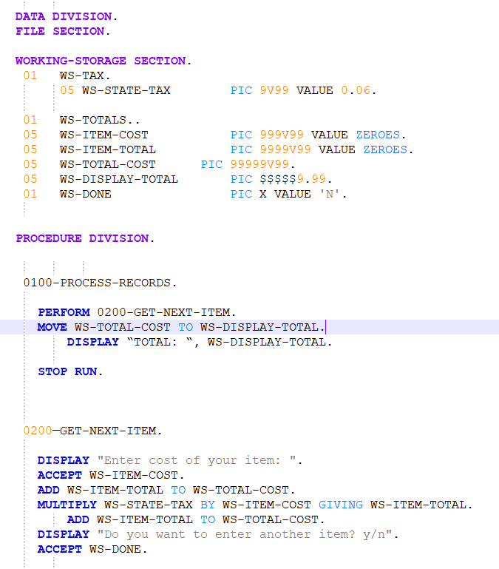
Cobol: Naming: Literal and Figurative Constants
Notice the paragraph 100-PROCESS-RECORDS area
PERFORM 200-GET-NEXT-ITEM – which transfers control down the green area
DISPLAY displays the string to prompt the user
The ACCEPT verb to read the value into WS-ITEM-COST
ADD verb adds to the WS-TOTAL-COST variable
MULTIPLY verb uses the WS-STATE-TAX and performs the calculation
ACCEPT WS-DONE goes back to the MOVE WS-TOTAL-COST to WS-TOTAL-COST. Line

Slide 14
Cobol: Naming: Literal and Figurative Constants
Notice the WS-DISPLAY-TOTAL which contains $$$$$9.99 which allows for floating dollar sign when displayed
Notice the figurative constant ZEROS initialize for WS-ITEM-COST and WS-ITEM-TOTAL variables
For a non-numeric field you could use a figurative constant of SPACES

